Slide 1

Bank Marketing & Customer Behavior
Predicting Term Deposit Subscriptions
NTI • Data Analytics Final Project
Team
Halla Ehab • Amr Faisal • Manar Desouki• Tarek Ahmed • Shaimaa Ashraf

Slide 2

Project Overview
Objective
Predict customer subscription to term deposits
Improve campaign targeting and ROI
Business Problem
Low conversion rates; high marketing cost per acquisition
Dataset
Direct-marketing campaigns (bank) — demographic, behavioral, campaign features

Slide 3

Data Preparation
Data Cleaning
Preprocessing
Missing values, outliers, inconsistent categories
Encoding, scaling, date parsing
Feature Engineering
Interaction terms, campaign recency, tenure buckets

Slide 4
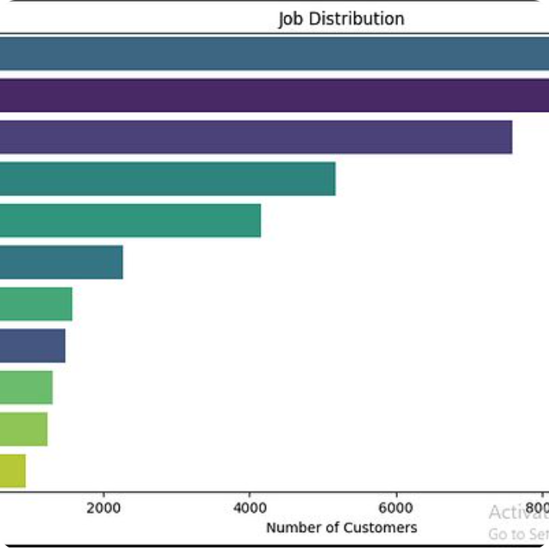
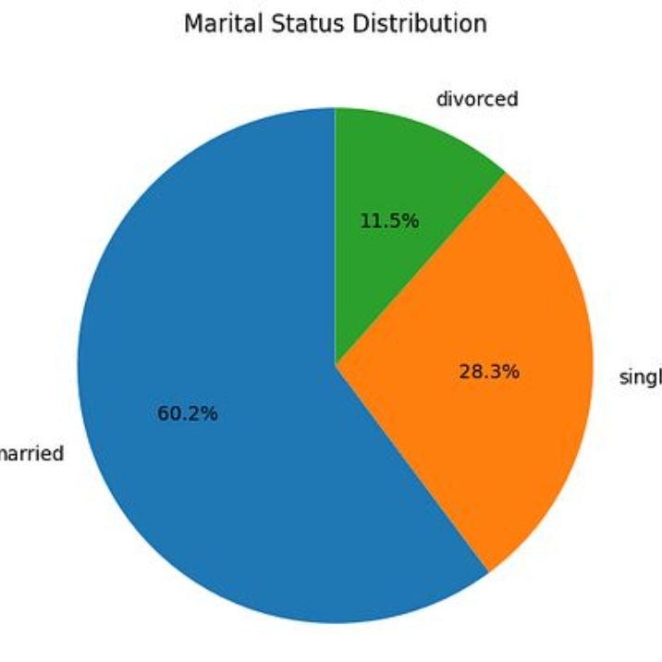
Exploratory Data Analysis
Visuals (placeholders)
Target distribution — class imbalance
Job — high/low conversion roles
Education — correlation with uptake
Correlation heatmap — feature relationships
Insights: target skewed toward No; job and campaign timing show strongest signals.

Slide 5
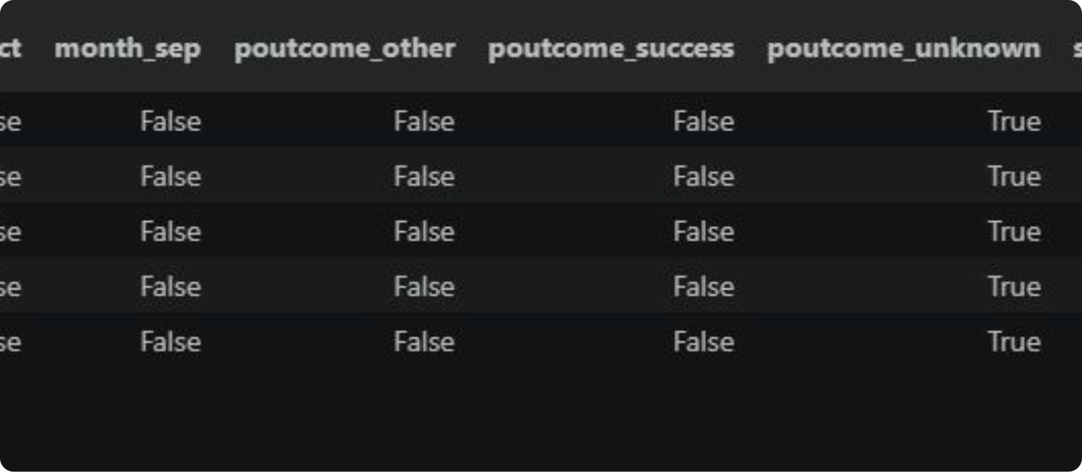
Machine Learning
Models Used
Logistic Regression • Random Forest • XGBoost • LightGBM
Train / Test
70/30 split • Stratified sampling • CV for hyperparameter tuning
Metrics
Placeholders for ROC and confusion matrix — add model outputs.
AUC-ROC • Precision • Recall • F1 • Confusion matrix

Slide 6
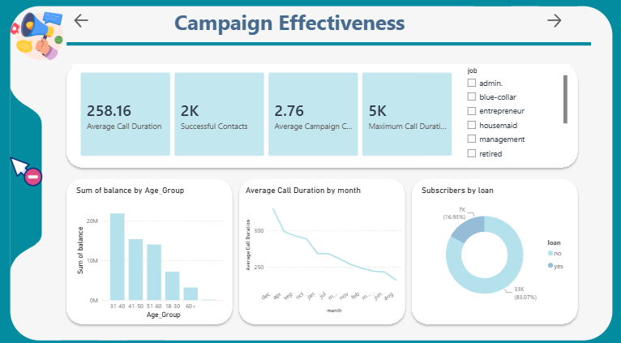
Power BI Dashboard
Interactive dashboard mockups — placeholders for final screenshots
Key views: Campaign Overview • Customer Segments • Campaign Effectiveness

Slide 7
Key Findings & Recommendations
Prioritize high-propensity segments
Optimize timing
Refine offer personalization
Leverage campaign recency and day-of-week signals
Target jobs and education cohorts with higher conversion rates
Use feature-derived segments for tailored messaging
Deploy model in marketing flow
Continuous measurement
A/B test model-driven campaigns; monitor lift and ROI
Score leads in real time; route to high-touch channels

Slide 8


Thank You
Thank you for your time and support throughout this journey. Special thanks to the NTI course for this valuable experience and to instructor Mayar Swilam for the guidance, encouragement, and knowledge shared along the way.
NTI
DATA ANALYTICS

